Slide 1
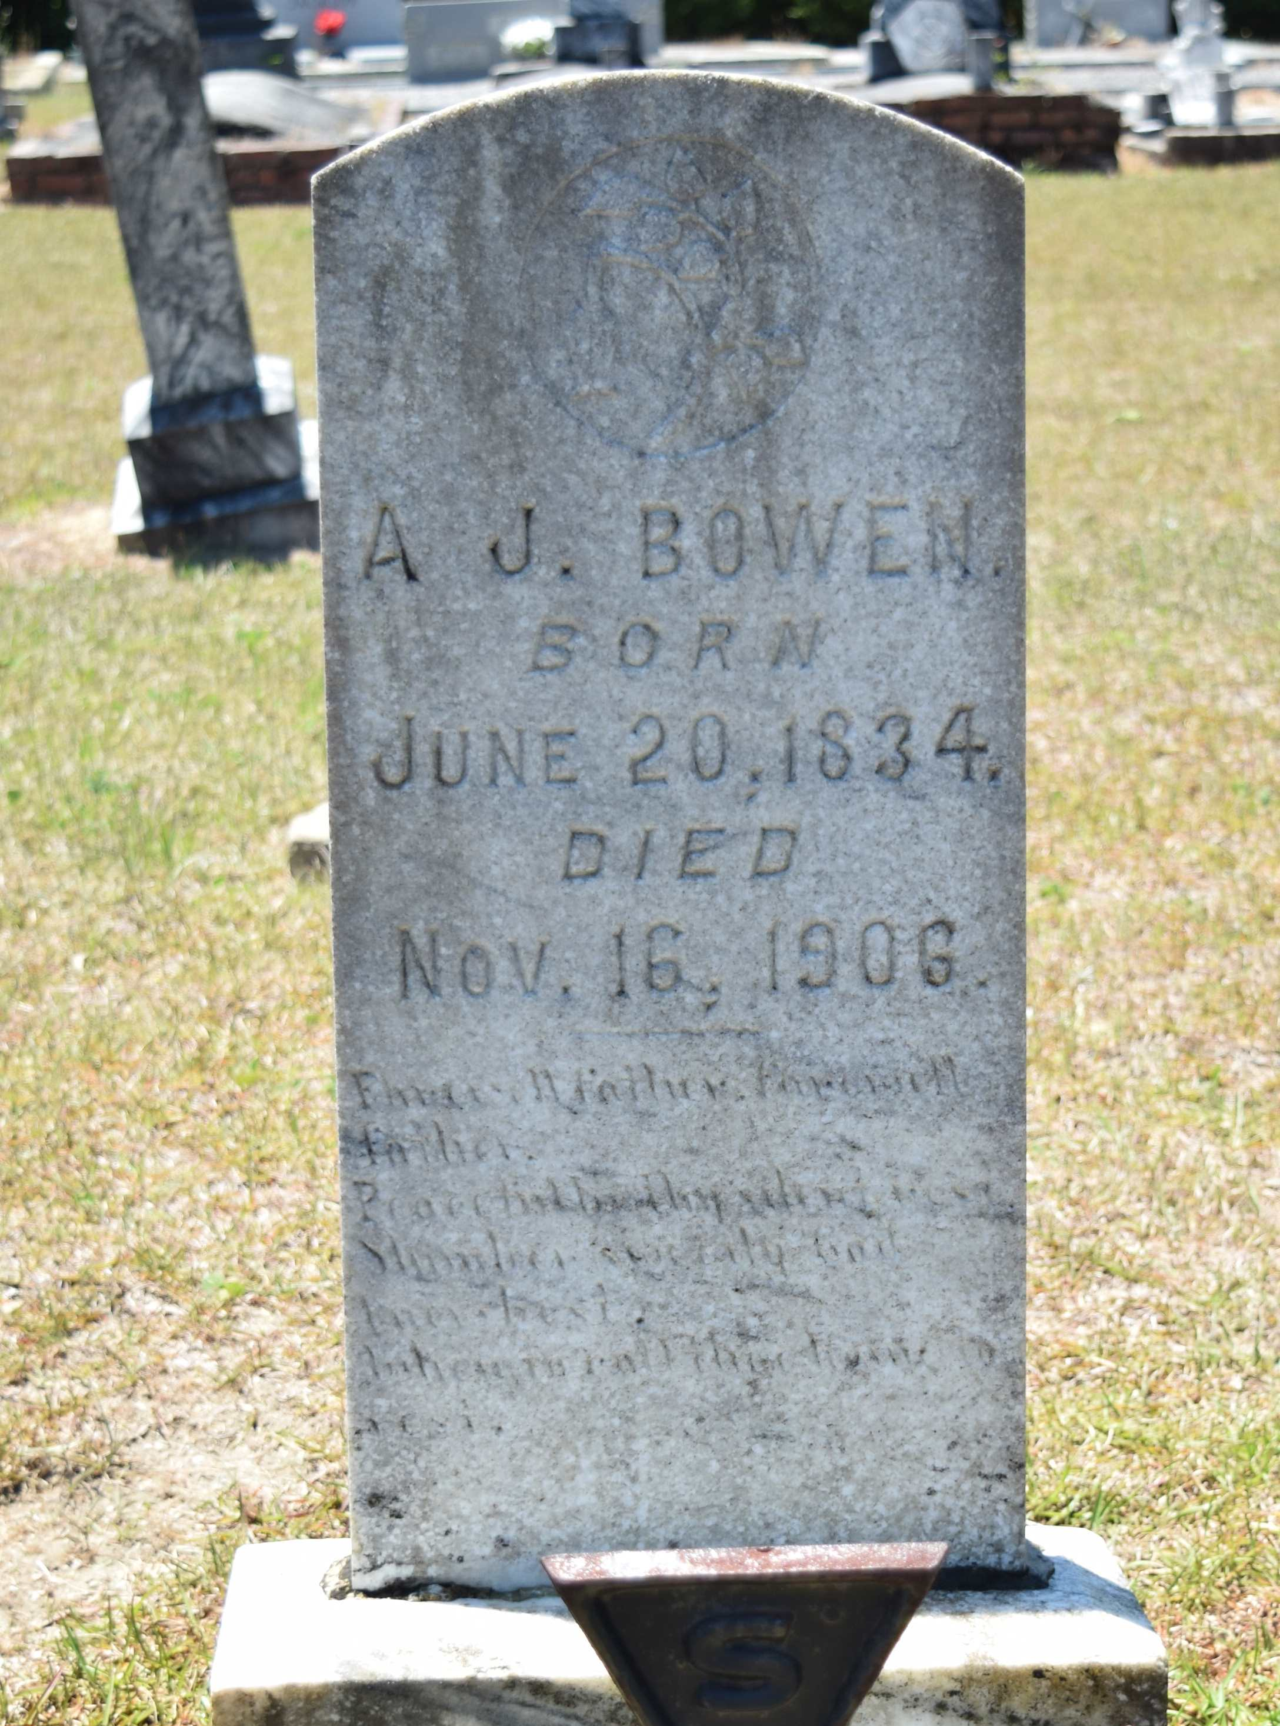
Andrew Jackson Bowen (1834-1906)
Amanda Hines (1847-1899)
  James B. Bowen (1863-1931)
  Mary Frances Bowen (1868-1935)
  Rachel Bowen (1872-1951)
  Edward Martin Bowen (1874-1937)
  Elizabeth Bowen (1877-1968)
  Green Durham Bowen (1880-1936)
  George Washington Bowen (1883-1954)
  Matthew Bowen (1886-?)
1850 Census Jefferson Co, GA
Windal Bowen 64
Milsa 49
Authaline 25
Zacka Durham 21
AJ 16
Milsa E 12
Elizabeth C 10
Nancy A Lindsey7
Manefsa Bowen5
Martha Brown 33
1860 Census Jefferson Co, GA
Windal Bowen 75
Milsa 63
Andrew 25
Emily M 22
Manephy 14
1870 Census Wrightsville, Johnson Co, GA
Andrew 35
Manda 30
James 7
Mollie 4
1880 Census Johnson Co, GA
Bowen A Head 44
Manda Wife 33
James Son 15
Mary Dau 13
Andrew Son 8
Rachel Dau 7
Martin Son 5
Elizabith Dau 3
Greane Son 3/12
1900 Census Washington Co, GA
John H Holt Head Sep 1867 32
Mollie F Wife Oct 1867 32
Willie J Son Jun 1891 8
Andrew Son Jun 1893 6
Thomas Son Jun 1893 6
Lizzie M Dau Aug 1896 3
Garnet W Son May 1898 2
Durham Bowen B-In-Law Mar 1881 19
George W B-In-Law Nov 1883 16
Matthew B-In-Law May 1886 14
Andrew F-In-Law Jun 1835 65

Slide 2
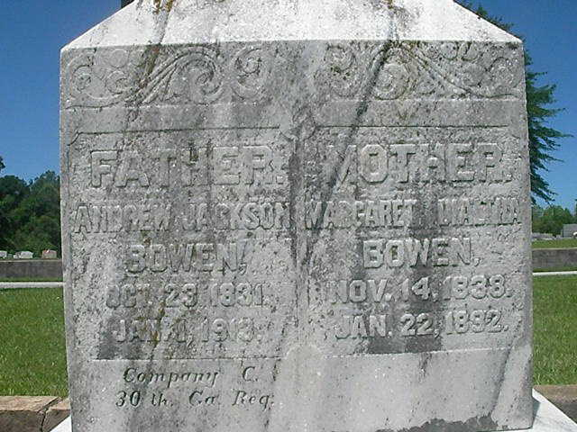
Andrew Jackson Bowen (1831-1913)
Margaret Dialtha Simmons (1838--1892)
Webster Blalock Bowen (1856-1937)
Thomas Jones Bowen (1858-1894)
James M Bowen (1860-1890)
Charles Jonathan Bowen (1866-1954)
Pillona Bowen (1869-1953)
Helen Viola “Ola” Bowen (1869-1952)
William Robert Jackson Bowen (1871-1951)
Caleb Edgar Bowen (1876-1930)
1860 Census Atlanta, Campbell Co, GA
Jackson Bowen 28
Margaret D 21
Webster B 4
Thomas D 2
1870 Census Atlanta, Douglas Co, GA
Jackson Bowen 38
M. D. 31
Webster 14
Thomas 12
Jas 10
Charles 4
Palona 2
Helen 9/12
1880 Census Atlanta, Douglas Co, GA
Jackson Bowen Head 49
Margaret Wife 39
Thomas Son 22
James Son 20
Charley Son 14
Perlona Dau 12
Viola Dau 10
Robert Son 8
Edgar Son 4
1900 Census Atlanta, Fulton Co, GA
Andrew Bowen Head Oct 1831 68
Lonie Dau Feb 1868 32
Ola Dau Sep 1869 30
Caleb Son Mar 1876 24
Pearl G Dau Aug 1887 12
1910 Census Atlanta, Fulton Co, GA
Andrew J Bowen Head 78
Pillona Dau 41
Lewis F Miliken Son-In-Law 55
Helen V Dau 40
Willie P G Dau 22
Charles R G Son 19
The following excerpted from the Atlanta Constitution with notes.
January 2, 1913, The Atlanta Constitution
Andrew J. Bowen
Andrew J. Bowen, aged 81, died at McPherson, Georgia, Wednesday morning. He is survived by two daughters, Miss Plonie Bowen, and Mrs. L. F. Miliken, and by four sons, W.B., C.J., W.R., and C.L., (s/b C.E.) who live in Atlanta. The body will be brought to Atlanta and services held at ??? Clay Street, where he formerly lived, Thursday afternoon at 3 o'clock. The body will then be taken to Douglasville for interment. Mr. Bowen was a Confederate veteran having fought in the Thirteith Georgia Regiment.

